Slide 1
Design and Application of Hybrid Classification System on Memory IC Testing

Slide 2
Description
In Memory IC testing, a number of electronic test will be conducted using programmable automatic electronic tester.
Electronic testing is not just used to sort out the failure. Its results can also be used to find out the failing positions inside the array which will then help to identify the failing cause.
A DRAM chip uses row and column to indicate the array cell position. Hence, understand whether row/column/individual cell failure is important.

Slide 3
Complication
Auto testing result can be affected noises and hence not always accurate, certain fail case is regarded as overkill.
The yield enhancement task force always looking for single bit (SB), row (ROW) and column (COL) fails inside the DRAM chips but 1 most IC can display more than 1 failing mechanism.
Hence, it is hard to predict the failing mechanism and most verification is done by inspection after the IC is de-capsuled.

Slide 4
Proposal
Using the existing IC testing data from 58 tests (58 features) and inspected failing mechanism (8 classes, namely Overkill, SB, COL, SB+COL, ROW, SB+ROW, COL+ROW, SB+COL+ROW), build a hybrid classification model.
The model uses Decision Tree, Multi-layer Perceptron and SVM.
The competitive agent will the compare the accuracy, feature-to-class correlation and penalize severe mis-classification listed below:
a) mis-classified as Overkill
b) mis-classified as totally unrelated class such as ROW as COL.

Slide 5
Overall Design
Three models, namely, decision tree, MLP, SVM will be built accordingly.
The output will then be evaluated by competitive agent.

Slide 6
Data Set
The Input data is in CSV format.
“1” represents test positive and “0” as test negative.
ID can be dropped at the beginning.
“SB”,”ROW”,”COL” are inspection result. Other than these columns, all the rest are automatic test result.
Test and Train split are in ratio of 2:1.
The output classes is formed from 3 columns in the raw data, namely, SB, COL, ROW.

Slide 7
Data Set
Expected class
#Forming 8 class from 3 columns, coded as 0 to 7
#['Overkill','SB','COL','SB+COL','ROW','ROW+SB','ROW+COL','SB+ROW+COL']
y = test_data.SB+2*test_data.COL+4*test_data.ROW

Slide 8
Decision Tree
Tuning will be made on tree Depth based on accuracy. Best depth chosen on best accuracy.
Fine tuning will then be made again on impurity decrease and min_weight_fraction_leaf based on accuracy.
The model will then be parsed to the competitive agent.

Slide 9
MLP

Slide 10
SVM

Slide 11
Competitive agent
Competitive agent will give score to each agent, namely, decision tree, MLP, SVM based on feature correlation and accuracy.
Penalty is given to each model based on mis-classification type illustrated by confusion matrix.

Slide 12
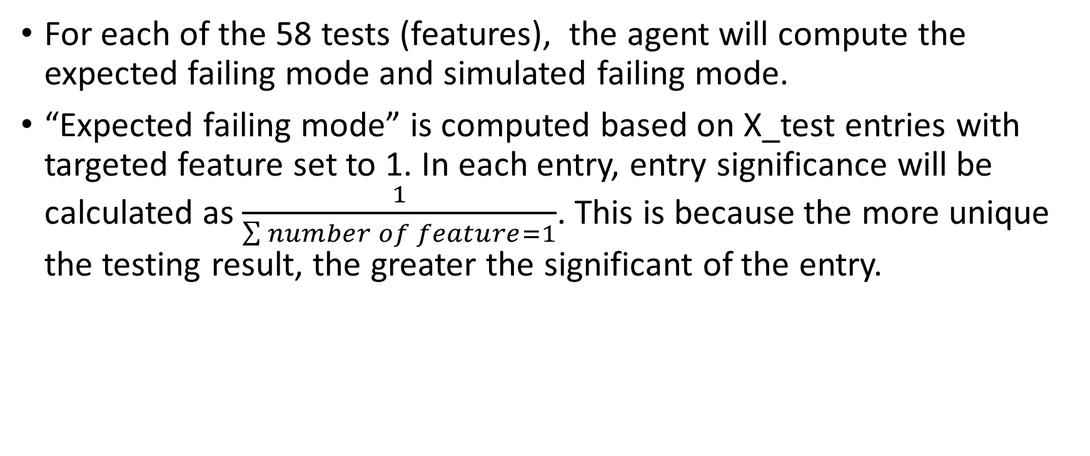
Feature Correlation
For each of the 58 tests (features), the agent will compute the expected failing mode and simulated failing mode.
“Expected failing mode” is computed based on X_test entries with targeted feature set to 1. In each entry, entry significance will be calculated as $\frac{1}{\sum{number of feature=1}}$. This is because the more unique the testing result, the greater the significant of the entry.

Slide 13
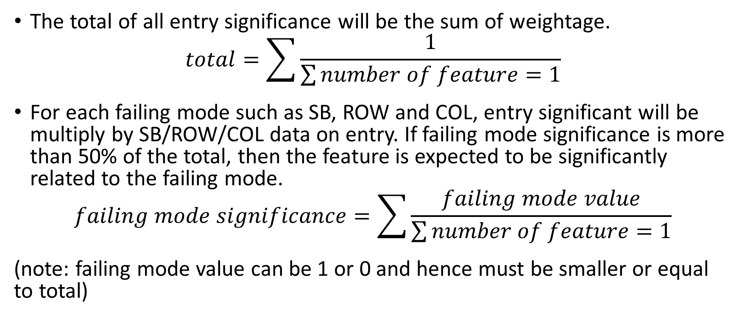
Feature Correlation
The total of all entry significance will be the sum of weightage.
$$total=\sum{\frac{1}{\sum{number of feature=1}}}$$
For each failing mode such as SB, ROW and COL, entry significant will be multiply by SB/ROW/COL data on entry. If failing mode significance is more than 50% of the total, then the feature is expected to be significantly related to the failing mode.
$$failing mode significance=\sum{\frac{failing mode value}{\sum{number of feature=1}}}$$
(note: failing mode value can be 1 or 0 and hence must be smaller or equal to total)

Slide 14
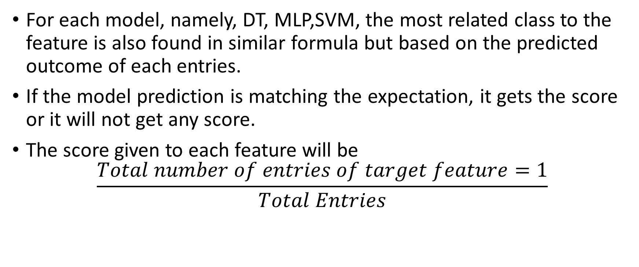
Feature Correlation
For each model, namely, DT, MLP,SVM, the most related class to the feature is also found in similar formula but based on the predicted outcome of each entries.
If the model prediction is matching the expectation, it gets the score or it will not get any score.
The score given to each feature will be
$$\frac{Total number of entries of target feature=1}{Total Entries}$$

Slide 15
Feature Correlation
Example:
In a test dataset of 1000 entries, feature A is 1 in 100 entries.
In the 1st entry, Feature A,B,C are set to 1, the rest to 0. Hence, significance is 1/3=0.33.
SB is 1 but COL and ROW are 0. Hence SB significance is 0.33 but B,C is zero.
At the 2nd Entry, Feature A,D are set to 1. Significance is ½=0.5 . Total significance is 0.33+0.5=0.83
SB and COL is 1 but ROW are 0. Hence SB total significance is 0.83 but B is 0.5 and C is still 0.

Slide 16
Feature Correlation
After accounting all the 100 entries, total significance is 50 while SB is 36, COL is 9, ROW is 1. Hence, we know we expect SB to be most related to the feature A.
Using model prediction outcome on the same 100 entries, we found that MLP and SVM is choosing SB for feature A but decision tree is choosing COL.
Hence, decision tree get zero score for feature A. MLP and SVM gets a score of 100/1000=0.1 mark.

Slide 17
Accuracy
The accuracy of each model will also be added on top of feature correlation score.

Slide 18
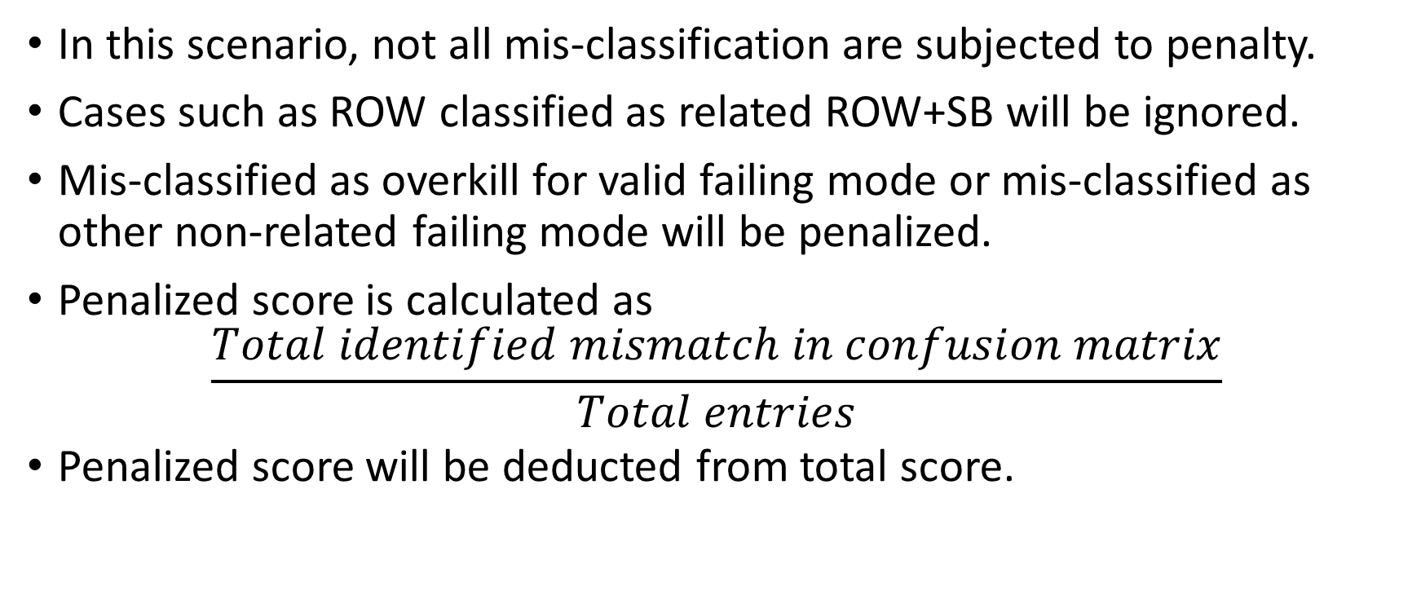
Mis-classification penalty
In this scenario, not all mis-classification are subjected to penalty.
Cases such as ROW classified as related ROW+SB will be ignored.
Mis-classified as overkill for valid failing mode or mis-classified as other non-related failing mode will be penalized.
Penalized score is calculated as
$$\frac{Total identified mismatch in confusion matrix}{Total entries}$$
Penalized score will be deducted from total score.

Slide 19
Best Choice
The competitive agent will choose the model with best total score. The detail of chosen agent will be printed out.
The total score= feature correlation score + accuracy score – mis-classification penalty

